Slide 1
Bringing the pieces together /
Detailed walkthrough of the reference example
Dr. Dennis Wendland
Technical Lead & Architect
FIWARE Foundation
dennis.wendland@fiware.org

Slide 2
Outline
Example overview
Prerequisites
Demo
What happened in the background
Creating an offering
Acquisition of offerings
Accessing the service
M2M Interaction
Setup of components on K8s

Slide 3
Example overview
Notes:
Overview of PoC, parties involved, architectural overview, intro to 3 example steps (create offer, acquisition, consumption)

Slide 4
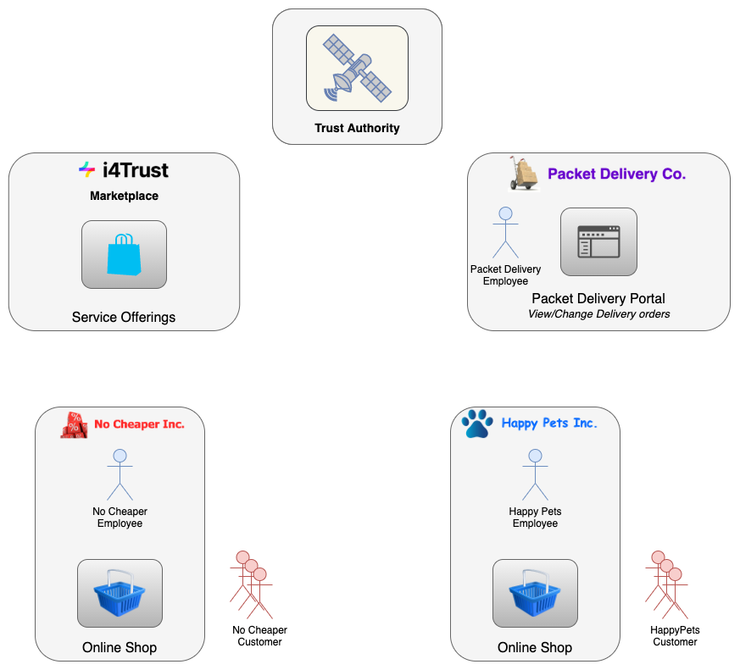
Example Overview
Showcase:
Delegation of data service access rights within trusted data space
Delegated from an organizational level to an user level
Service provider does not need knowledge about users which finally access the service
Parties:
Packet Delivery Co. offers delivery order service on i4Trust Marketplace
Different retailers (shops) acquire access to service offering
Retailers delegate service access to their customers
Trust Authority ensures trust among different organisations
Steps:
Creating an offering (by Packet Delivery Co.)
Acquiring an offering (by retailers)
Accessing packet delivery order service (by retailer customers)
Notes:
PoC Intro, showcase: delegation of data service access rights from organizational to user level, whole process divided into 3 steps

Slide 5

Example Overview
Packet Delivery Company + Marketplace
Packet Delivery Co. provides digital service about its packet delivery orders
Delivery orders map to Digital Twin entities characterized by
issuer, destinee
originAddress, deliveryAddress
pda/pta (planned date/time of arrival)
eda/eta (estimated date/time of arrival)
Different service levels offered for users accessing the service:
Standard: Read access to delivery orders (HTTP GET)
Gold: Allowed to change destinee, deliveryAddress, pta, pda of delivery orders (HTTP PATCH)
Packet Delivery Co. publishes its offering on i4Trust Marketplace for acquisition by organisations (e.g. retailers/shops)
Basic: Organisations can only offer PacketDelivery:Standard service level to its customers
Premium: Organisations can assign PacketDelivery:Standard and PacketDelivery:Gold service level to its customers
Notes:
PDC&Marketplace: intro, 2 offerings, created at MP (step 1)

Slide 6
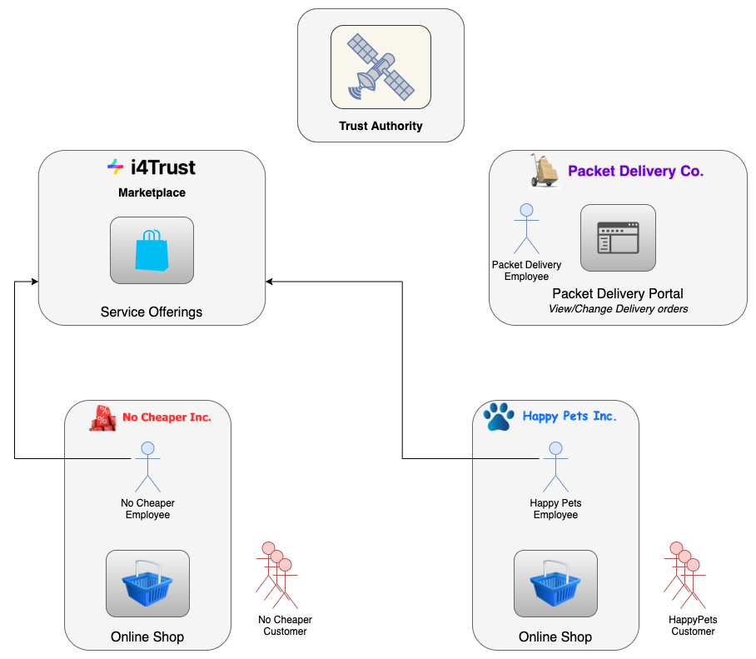
Example Overview
Shops
Happy Pets Inc.:
Shop of premium products of pets
Acquires Premium packet delivery offering on Marketplace
Can offer Standard and Gold service to its customers
No Cheaper Inc.:
Shop of bargain clothes at big discounts
Acquires Basic packet delivery offering on Marketplace
Can offer only Standard service to its customers
Notes:
Shops: intro, customers, acquire different offerings (step 2)

Slide 7

Example Overview
Customers
Customers:
Both shops have (human) customers
After checkout at the shop, delivery orders at Packet Delivery Co. are generated
Customers might want to view and/or change their delivery orders at the Packet Delivery Co. portal
Change of delivery orders only allowed for customers of Happy Pets Inc.
Notes:
Customer: intro, changes attrs of order (step 3)

Slide 8
Prerequisites
Notes:
Prerequisites at different parties environments, iSHARE registration and certificates, pre-registration of users and policies (incl. for AS), API-Umbrella config, creating delivery orders at CB

Slide 9
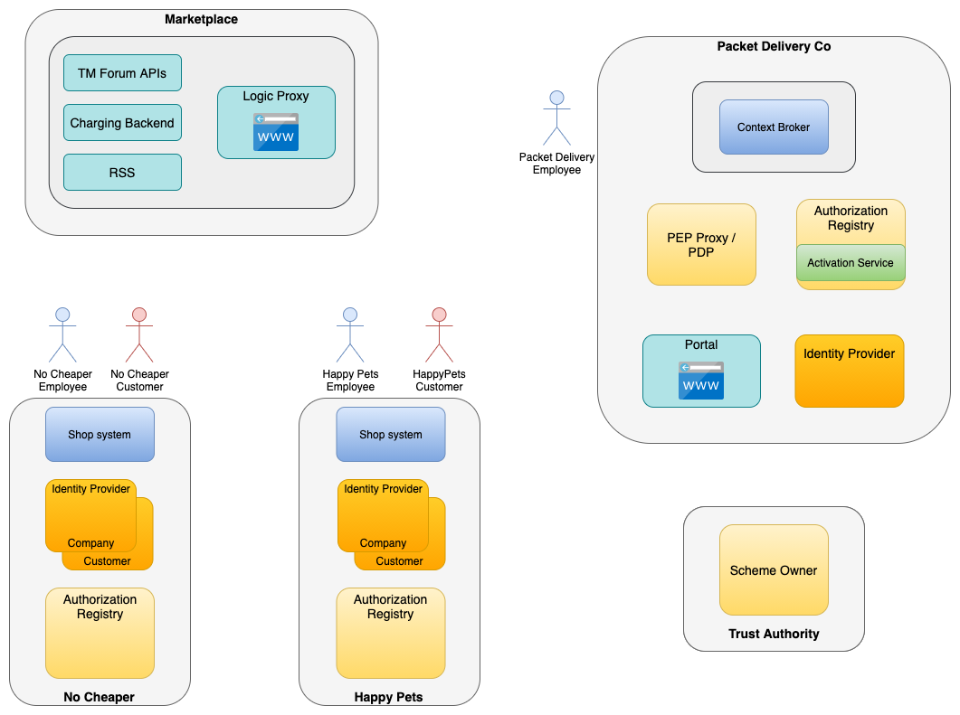
Prerequisites
Architectural overview
Marketplace
Business API Ecosystem
Happy Pets Inc.
Identity Provider(s)
Authorisation Registry (AR)
Shop system application
No Cheaper Inc.
Identity Provider(s)
Authorisation Registry (AR)
Shop system application
Packet Delivery Co.
Context Broker
Identity Provider
PEP Proxy/PDP
Authorisation Registry (AR) + Activation Service (AS)
Portal application
Trust Authority
iSHARE Satellite
Notes:
Architecture overview: ENVs

Slide 10
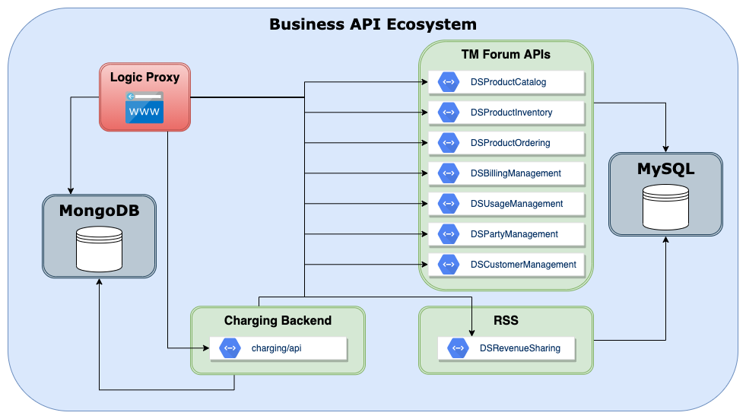
Prerequisites
Marketplace
Databases used by different marketplace components
MongoDB
MySQL
TM Forum APIs
Reference implementation
Charging Backend
Rating, charging and billing
RSS
Revenue settlement and sharing
Logic Proxy
UI portal, authentication and API orchestrator
No further prerequisites needed
Notes:
Marketplace prereqs

Slide 11
Prerequisites
Trust Authority
Installed per data space
Using iSHARE Satellite
https://scheme.isharetest.net/swagger/index.html
Each participating organisation, procures certificates/private keys and EORI IDs for registration
Marketplace: EU.EORI.NLMARKETPLA
Packet Delivery: EU.EORI.PACKETDEL
Happy Pets: EU.EORI.NLHAPPYPETS
No Cheaper: EU.EORI.NLNOCHEAPER
iSHARE Satellite: EU.EORI.NL000000000
This information must be known to trust authority
Allows all participants to verify status of each organisation
Notes:
iSHARE Satellite: Certs and EORIs (list of EORIs)

Slide 12
Prerequisites
Shop: Happy Pets Inc.
Happy Pets Ltd.
Customer
{
"policyIssuer": "EU.EORI.NLHAPPYPETS",
"accessSubject": "<CUSTOMER-USER-ID>",
"policies": [
{
"target": {
"resource": {
"type": "DELIVERYORDER",
"identifiers":
["<DELIVERY-ORDER-ID>"],
"attributes":
["pta","pda"]
},
"actions": ["PATCH", "GET"]
}
]
}
2 Identity providers to be deployed with pre-registered users
Company (login @ marketplace)
Employee user
Customer (login @ shop and packet delivery portal)
Standard customer user
Gold customer user
Authorisation Registry instance
Holds customer access policies
Using iSHARE AR test instance: https://ar.isharetest.net/swagger/index.html
Shop system
Skipped for simplicity
In the following assume:
Customer users already registered
Pre-existing delivery orders for each customer
Standard/Gold policies already assigned to customers
Initial delivery orders to be created manually (next slides)
Customer policies (Standard/Gold) to be created manually
Gold
Notes:
HappyPets: shop system skipped for simplicity, 2 IDPs with pre-registered accounts (employee@company, customers@customer), customer policies @ AR

Slide 13
Prerequisites
Shop: No Cheaper Inc.
No Cheaper Ltd.
Customer
{
"policyIssuer": "EU.EORI.NLNOCHEAPER",
"accessSubject": "<CUSTOMER-USER-ID>",
"policies": [
{
"target": {
"resource": {
"type": "DELIVERYORDER",
"identifiers":
["<DELIVERY-ORDER-ID>"],
"attributes":
["*"]
},
"actions": ["GET"]
}
]
}
2 Identity providers to be deployed with pre-registered users
Company (login @ marketplace)
Employee user
Customer (login @ shop and packet delivery portal)
Standard customer user
Gold customer user could also be created to demonstrate denied access with PATCH request
Authorisation Registry instance
Holds customer access policies
Using iSHARE AR test instance: https://ar.isharetest.net/swagger/index.html
Shop system
Skipped for simplicity
In the following assume:
Customer users already registered
Pre-existing delivery orders for each customer
Standard policies already assigned to customers
Initial delivery orders to be created manually (next slides)
Customer policies (Standard) to be created manually
Standard
Notes:
HappyPets: shop system skipped for simplicity, 2 IDPs with pre-registered accounts (employee@company, customers@customer), customer policies @ AR

Slide 14
Prerequisites
Packet Delivery Co.
Packet Delivery Portal application
Demo application available
Identity Provider to be deployed with pre-registered user
Employee user
Context Broker as Service provider
Provides NGSI-LD API for
Reading delivery order entities (HTTP GET)
Changing delivery order entities (HTTP PATCH)
Initial delivery order entities to be created manually
{
"id": "urn:ngsi-ld:DELIVERYORDER:HAPPYPETS001",
"type": "DELIVERYORDER",
"issuer": {
"type": "Property",
"value": "Happy Pets"
},
"destinee": {
"type": "Property",
"value": "Happy Pets customer"
},
....
"pda": {
"type": "Property",
"value": "2021-10-02"
},
"pta": {
"type": "Property",
"value": "14:00:00"
},
"eda": {
"type": "Property",
"value": "2021-10-02"
},
"eta": {
"type": "Property",
"value": "14:00:00"
},
"@context": [
"https://schema.lab.fiware.org/ld/context", "https://uri.etsi.org/ngsi-ld/v1/ngsi-ld-core-context.jsonld"
]
}
Notes:
PDC: CB with delivery orders, IDP with employee user, AR+AS with policy for creating policies @ marketplace, setup portal, setup proxy

Slide 15
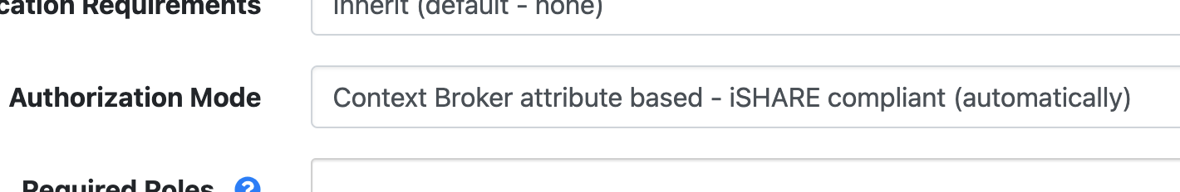
Prerequisites
Packet Delivery Co.
PEP Proxy / PDP
Using API Umbrella
API Backend (Context Broker) configured with attribute based authorization mode
Authorisation Registry instance
Holds organisational access policies
Using iSHARE AR test instance
Activation Service
Demo application available
Required for enabling Marketplace to create policies at AR of Packet Delivery
Marketplace policy to be created initially
Packet Delivery Co.
Marketplace
{
"policyIssuer": "EU.EORI.NLPACKETDEL",
"accessSubject": "EU.EORI.NLMARKETPLA",
"policies": [
{
"target": {
"resource": {
"type": "delegationEvidence",
"identifiers":
["*"],
"attributes":
["*"]
},
"actions": ["POST"]
}
]
}
Notes:
PDC: CB with delivery orders, IDP with employee user, AR+AS with policy for creating policies @ marketplace, setup portal, setup proxy

Slide 16
Demo
Create an offering
Acquire access to an offering
Access the service

Slide 17
What happened in the background
Creating an offering

Slide 18
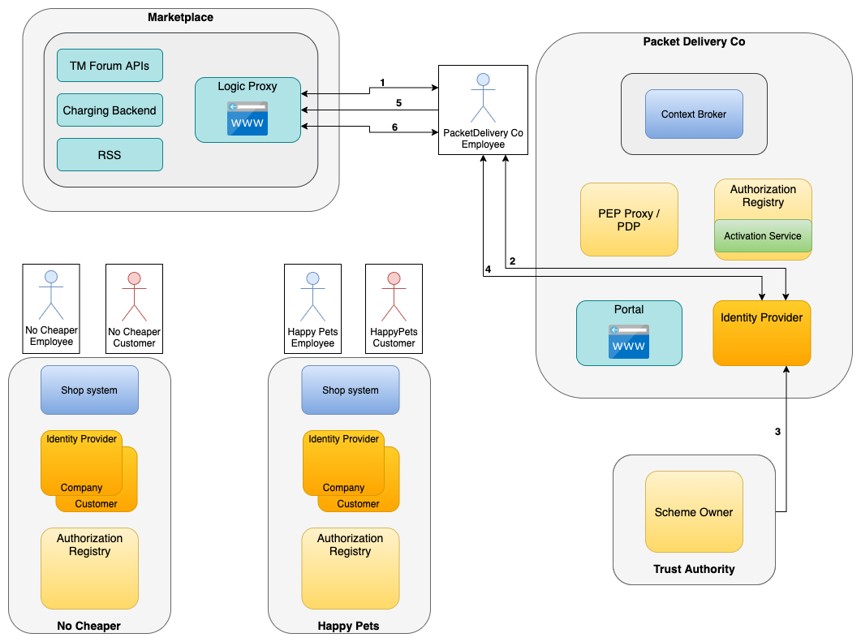
Creating an offering
Employee of Packet Delivery Co. creates offering on Marketplace for its basic and premium services
Employee requests login on Marketplace based on OIDC using its own IDP (1-2)
IDP validates against Trust Authority whether Marketplace is a trusted party (3)
Employee performs login based on OIDC standard (4-5)
Employee has logged in and creates offerings for standard and premium services (6)
Provides information to offering description about:
Service endpoint (+ API specification)
Data model used
Security requirements (e.g. policies supported)
Other terms and Conditions, pricing

Slide 19
What happened in the background
Acquiring access rights and activating the service

Slide 20
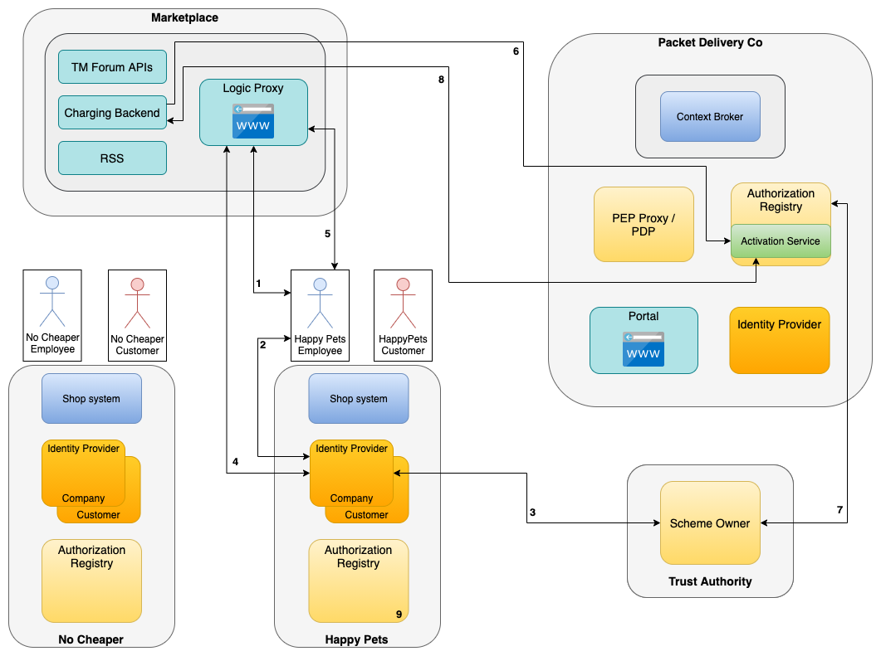
Acquisition of offerings
Employee of Happy Pets Ltd acquires access to premium service offering
Employee requests login on Marketplace based on OIDC using its own IDP (1-2)
IDP validates Marketplace as trusted party, login is performed based on OIDC and Employee is presented available offerings (3-4)
Employee selects the Packet Delivery premium service and performs the checkout process incl. providing payment details (5)
Marketplace requests at Packet Delivery AR to register HappyPets as organization able to assign Packet Delivery premium service policies to its customers (6)
Authentication at AR based on OAuth2
AR validates Marketplace as trusted party (7)
Policy is created at AR, allowing Happy Pets to delegate premium service access to its customers (8)
Policy allowing premium access needs to be assigned at Happy Pets AR to its customers (9)
Notes:
Show policy examples being created

Slide 21
Acquisition of offerings
Employee of Happy Pets Ltd acquires access to premium service offering
Employee requests login on Marketplace using its own IDP (1-2)
IDP validates Marketplace as trusted party, login is performed based on OIDC and Employee is presented available offerings (3-4)
Employee selects the Packet Delivery premium service and performs the checkout process incl. providing payment details (5)
Marketplace requests at Packet Delivery AR to register HappyPets as organization able to assign Packet Delivery premium service policies to its customers (6)
AR validates Marketplace as trusted party (7)
Policy is created at AR, allowing Happy Pets to delegate premium service access to its customers (8)
Policy allowing premium access needs to be assigned at Happy Pets AR to its customers (9)
Packet Delivery Co.
Happy Pets Ltd.
{
"policyIssuer": "EU.EORI.NLPACKETDEL",
"accessSubject": "EU.EORI.NLHAPPYPETS",
"policies": [
{
"target": {
"resource": {
"type": "DELIVERYORDER",
"identifiers":
["*"],
"attributes":
["pta","pda"]
},
"actions": ["PATCH", "GET"]
}
]
}
Notes:
Show policy examples being created

Slide 22

Acquisition of offerings
Scenario: No Cheaper
Employee of No Cheaper Ltd acquires access to basic service offering
Employee signs in at marketplace and selects Packet Delivery Basic Service offering (1)
Marketplace requests at Packet Delivery AR to register No Cheaper as organization able to assign Packet Delivery basic service policies to its customers (2)
AR validates Marketplace as trusted party
Policy is created at AR, allowing Happy Pets to delegate premium service access to its customers
Policy allowing basic access needs to be assigned at No Cheaper AR to its customers
Packet Delivery Co.
No Cheaper Ltd.
{
"policyIssuer": "EU.EORI.NLPACKETDEL",
"accessSubject": "EU.EORI.NLNOCHEAPER",
"policies": [
{
"target": {
"resource": {
"type": "DELIVERYORDER",
"identifiers":
["*"],
"attributes":
["*"]
},
"actions": ["GET"]
}
]
}
Notes:
Show policy examples being created

Slide 23
What happened in the background
Accessing the service

Slide 24

Usage of data service
Login at portal
Customer of Happy Pets Ltd. Performs login at Packet Delivery portal
Customer requests login at portal using Happy Pets IDP (1-2)
IDP validates against Trust Authority whether portal is a trusted party (3)
Login is performed based on OIDC standard, the issued signed JWT contains info about Happy Pets AR where to retrieve user policies from (4)
JWT could also directly contain user policies
Customer is presented details about its delivery order (5)
Happy Pets Ltd.
Customer
{
"policyIssuer": "EU.EORI.NLHAPPYPETS",
"accessSubject": "<CUSTOMER-USER-ID>",
"policies": [
{
"target": {
"resource": {
"type": "DELIVERYORDER",
"identifiers":
["<DELIVERY-ORDER-ID>"],
"attributes":
["pta","pda"]
},
"actions": ["PATCH", "GET"]
}
]
}

Slide 25
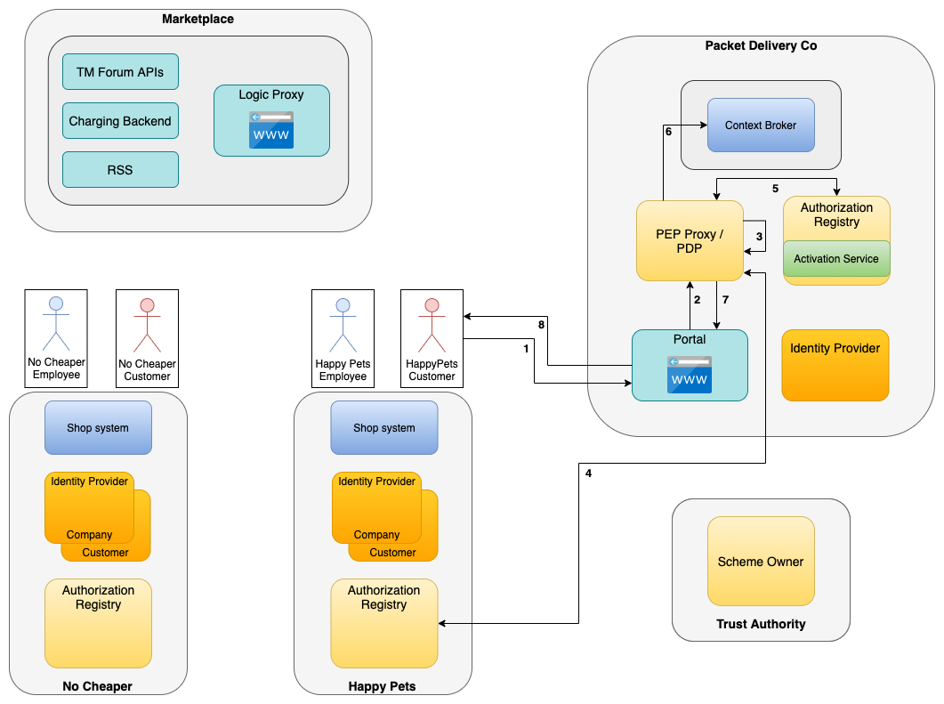
Usage of data service
Change Delivery Order
Customer of Happy Pets Ltd. changes PDA/PTA of its delivery order
Customer triggers sending of request to change PDA/PTA which includes the signed JWT (1-2)
Proxy validates and verifies JWT (3)
Proxy requests user policies at Happy Pets AR, and validates if customer was assigned the necessary premium service policy (4)
Alternatively JWT could already contain user policies and this step could be skipped
Proxy checks at Packet Delivery AR if Happy Pets was able to assign premium service policy to its customers (5)
Request is forwarded to Context Broker, attributes are changed and confirmation is displayed at portal (6-8)

Slide 26
Usage of data service
Change Delivery Order
Customer of Happy Pets Ltd. changes PDA/PTA of its delivery order
Customer triggers sending of request to change PDA/PTA which includes the signed JWT (1-2)
Proxy validates JWT (3)
Proxy requests user policies at Happy Pets AR, and validates if customer was assigned the necessary premium service policy (4)
Alternatively JWT could already contain user policies and this step could be skipped
Proxy checks at Packet Delivery AR if Happy Pets was able to assign premium service policy to its customers (5)
Request is forwarded to Context Broker, attributes are changed and confirmation is displayed at portal (6-8)
Packet Delivery Co.
Happy Pets Ltd.
{
"policyIssuer": "EU.EORI.NLPACKETDEL",
"accessSubject": "EU.EORI.NLHAPPYPETS",
"policies": [
{
"target": {
"resource": {
"type": "DELIVERYORDER",
"identifiers":
["*"],
"attributes":
["pta","pda"]
},
"actions": ["PATCH", "GET"]
}
]
}
Happy Pets Ltd.
Customer
{
"policyIssuer": "EU.EORI.NLHAPPYPETS",
"accessSubject": "<CUSTOMER-USER-ID>",
"policies": [
{
"target": {
"resource": {
"type": "DELIVERYORDER",
"identifiers":
["<DELIVERY-ORDER-ID>"],
"attributes":
["pta","pda"]
},
"actions": ["PATCH", "GET"]
}
]
}

Slide 27
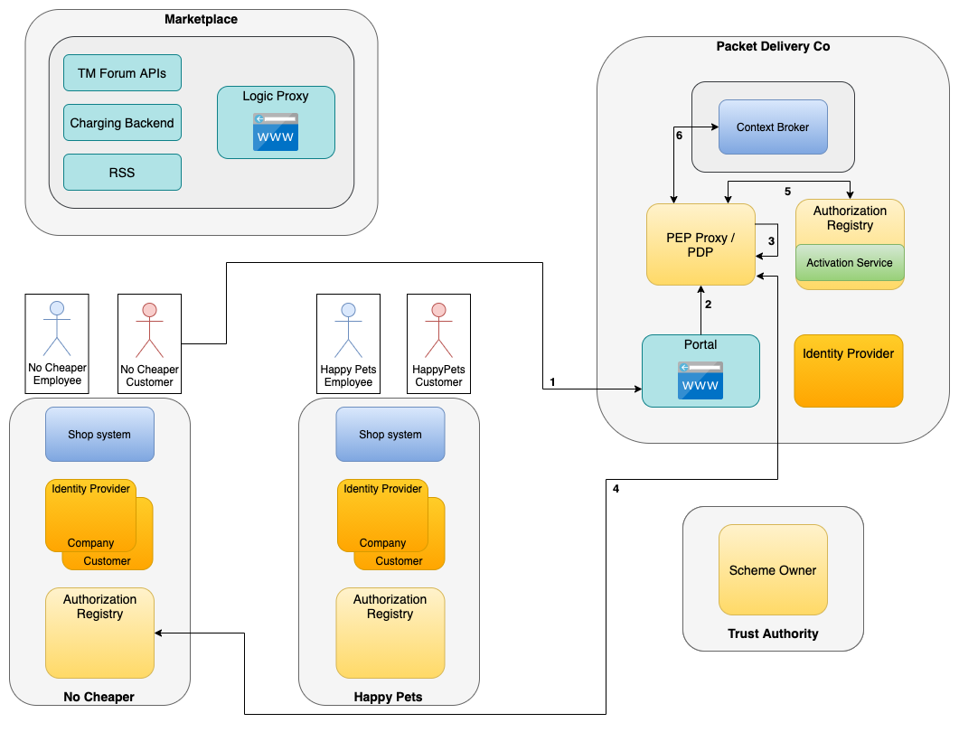
Usage of Data Service
Scenario: No Cheaper
Additional scenario for No Cheaper organization
No Cheaper acquired basic service offering
Only read access allowed at Packet Delivery service
No Cheaper is only allowed to assign standard service policies to its customers
A request for changing PTA/PDA by No Cheaper customer will get rejected at PEP Proxy / PDP
Request would also get rejected, even if No Cheaper would assign premium service policy to its customers
Packet Delivery Co.
No Cheaper Ltd.
{
"policyIssuer": "EU.EORI.NLPACKETDEL",
"accessSubject": "EU.EORI.NLNOCHEAPER",
"policies": [
{
"target": {
"resource": {
"type": "DELIVERYORDER",
"identifiers":
["*"],
"attributes":
["*"]
},
"actions": ["GET"]
}
]
}
No Cheaper Ltd.
Customer
{
"policyIssuer": "EU.EORI.NLNOCHEAPER",
"accessSubject": "<CUSTOMER-USER-ID>",
"policies": [
{
"target": {
"resource": {
"type": "DELIVERYORDER",
"identifiers":
["<DELIVERY-ORDER-ID>"],
"attributes":
["*"]
},
"actions": ["GET"]
}
]
}

Slide 28
Another scenario (not shown)
M2M Interaction

Slide 29
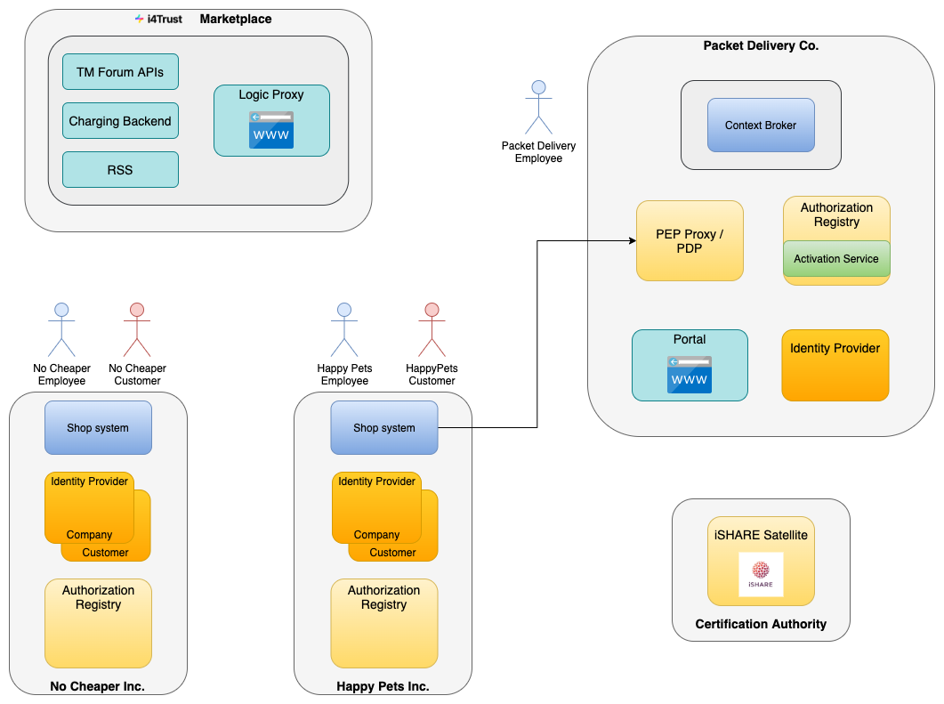
M2M Interaction
Previous use case showcased Human-to-Machine (H2M) interaction
End-user was accessing the service
Framework also supports Machine-to-Machine (M2M) interactions
Implementations part of upcoming releases of Keyrock and API Umbrella
Possible use case: Creation of delivery order
When customer ordered a product, a delivery order needs to be created when product is ready for pickup
Could be done directly by shop system at Packet Delivery Service
Requires additional offering
Created policies would be issued to retailer organisation and allow POST requests for entities of type DELIVERYORDER
No human involved

Slide 30

M2M Interaction
Shop system automatically creates a delivery order after a customer placed an order and product is ready to be picked up
Shop system creates signed JWT for identification and requests an access token at token endpoint* of Packet Delivery (1)
Packet Delivery validates HappyPets as trusted participant (2)
A signed JWT is returned as access token (3)
Shop system sends POST request (with access token) for creating a delivery order to proxy of Packet Delivery (4)
Proxy validates and verifies access token, then checks at Packet Delivery AR if Happy Pets was issued policy for creating delivery orders (5)
Request is forwarded to Context Broker and delivery order gets created (6)
*: Service Provider needs to be provide a token endpoint
⇒ Using IDP here, since this functionality is implemented in Keyrock

Slide 31
M2M Interaction
POST /oauth2/token
grant_type=urn:ietf:params:oauth:grant-type:jwt-bearer&
scope=iSHARE&
client_id=EU.EORI.NLHAPPYPETS&
client_assertion_type=urn:ietf:params:oauth:client-assertion-type:jwt-bearer&
client_assertion=<iSHARE_JWT>
Shop system automatically creates a delivery order after a customer placed an order and product is ready to be picked up
Shop system creates signed JWT for identification and requests an access token at token endpoint* of Packet Delivery (1)
Packet Delivery validates HappyPets as trusted participant (2)
A signed JWT is returned as access token (3)
Shop system sends POST request (with access token) for creating a delivery order to proxy of Packet Delivery (4)
Proxy validates and verifies access token, then checks at Packet Delivery AR if Happy Pets was issued policy for creating delivery orders (5)
Request is forwarded to Context Broker and delivery order gets created (6)
*: Service Provider needs to be provide a token endpoint
⇒ Using IDP here, since this functionality is implemented in Keyrock
{
"iss": "EU.EORI.NLPACKETDEL",
"sub": "EU.EORI.NLHAPPYPETS",
"jti": "070a5ed6-e840-47c3-bf36-4fa031a08324",
"iat": 1631170299,
"exp": 1631170299,
"aud": "EU.EORI.NLPACKETDEL"
}
Packet Delivery Co.
Happy Pets Ltd.
{
"policyIssuer": "EU.EORI.NLPACKETDEL",
"accessSubject": "EU.EORI.NLHAPPYPETS",
"policies": [
{
"target": {
"resource": {
"type": "DELIVERYORDER",
"identifiers":
["*"],
"attributes":
["*"]
},
"actions": ["POST"]
}
]
}

Slide 32
Setup of components of the i4Trust experimentation framework on Kubernetes
Notes:
K8s deployment instructions, header size config!!!!

Slide 33
Deployment
Marketplace: Business API Ecosystem
Need to deploy databases, elasticsearch and BAE
Helm charts available
MongoDB: bitnami/mongodb (DB: v3.6.21)
MySQL: t3n/mysql (DB: v5.7)
elasticsearch: elastic/elasticsearch (v7.5.1)
Business API Ecosystem: fiware/business-api-ecosystem (v8.0.0)
Need to supply config parameters as values when deploying with helm
Resources:
https://github.com/FIWARE-TMForum/Business-API-Ecosystem
https://business-api-ecosystem.readthedocs.io/en/latest/
https://github.com/i4Trust/tutorials/tree/main/i4Trust-Marketplace
helm repo add elastic https://helm.elastic.co
helm repo add t3n https://storage.googleapis.com/t3n-helm-charts
helm repo add bitnami https://charts.bitnami.com/bitnami
helm repo add fiware https://fiware.github.io/helm-charts/
helm install -f ./values.yml elastic elastic/elasticsearch --version 7.5.1
helm install -f ./values.yml mysql t3n/mysql --version 0.1.0
helm install -f ./values.yml mongodb bitnami/mongodb --version 10.0.5
helm install -f ./values.yml business-api-ecosystem /path/to/chart --version 0.2.5
BAE Component | Docker Image
BAE APIs | fiware/biz-ecosystem-apis:v7.6.0
BAE RSS | fiware/biz-ecosystem-rss:v8.0.0
BAE Charging Backend | fiware/biz-ecosystem-charging-backend:v8.0.0
BAE Logic Proxy | fiware/biz-ecosystem-logic-proxy:v8.0.0
Need to add service asset plugin to charging backend component
https://github.com/i4Trust/bae-i4trust-service
https://business-api-ecosystem.readthedocs.io/en/latest/plugins-guide.html#installing-asset-plugins
Notes:
Marketplace prereqs

Slide 34
Deployment
Identity Providers: Keyrock
Several IDP instances to be deployed for the different organisations/environments
Helm chart available: fiware/keyrock (8.1)
Need to supply config parameters as values when deploying with helm
Keyrock requires MySQL database, can use the one previously deployed
Need to specify separate database within MySQL
Resources:
https://github.com/ging/fiware-idm
https://fiware-idm.readthedocs.io/en/latest/
https://github.com/i4Trust/tutorials/tree/main/Data-Service-Provider#keyrock
Component | Docker Image
Keyrock | fiware/idm:8.1.0
# To be performed for each Keyrock instance (change release name)
helm install -f ./values.yml keyrock /path/to/chart --version 0.1.4

Slide 35
Deployment
Service provider: Context Broker
Deploy instance of orion context broker
Helm chart available: fiware/orion (1.0.1)
Need to supply config parameters as values when deploying with helm
Orion requires MongoDB database, can use the one previously deployed
Need to specify separate database within MongoDB
Resources:
https://fiware-orion.readthedocs.io/en/master/
Component | Docker Image
Orion Context Broker | fiware/orion-ld:1.0.1
helm repo add fiware https://fiware.github.io/helm-charts/
helm install -f ./values.yml orion fiware/orion --version 0.0.18

Slide 36
Deployment
PEP/PDP: API Umbrella
Deploy instance of API Umbrella
Helm chart available: fiware/api-umbrella (0.15.5)
Need to supply config parameters as values when deploying with helm
API Umbrella requires MongoDB database and elasticsearch, can use the ones previously deployed
Need to specify separate database within MongoDB
Resources:
https://api-umbrella.readthedocs.io/en/latest/
https://github.com/FIWARE/api-umbrella
https://github.com/i4Trust/tutorials/tree/main/Data-Service-Provider#api-umbrella
Component | Docker Image
API Umbrella | fiware/api-umbrella:0.15.5
helm install -f ./values.yml api-umbrella /path/to/chart --version 0.0.5

Slide 37
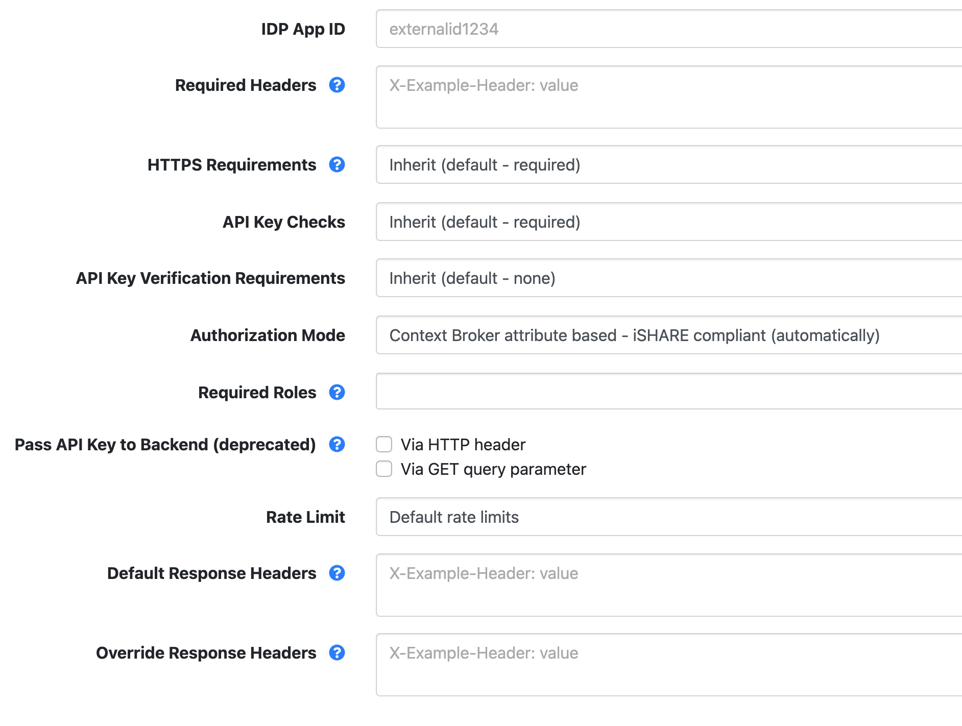
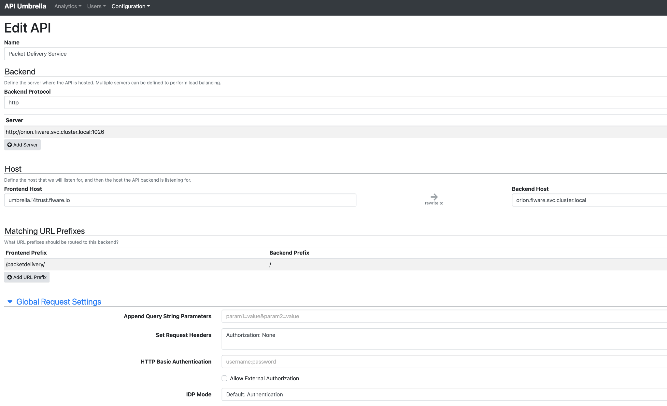
Deployment
PEP/PDP: API Umbrella
Configure API Backend for orion Context Broker instance in API Umbrella
Authorization Mode
Local orion endpoint
External host for publicly accessing the service
Prefix
Overwrite Authorization header, so that it is not forwarded to orion

Slide 38
Deployment
Packet Delivery Co.: Portal + AS
Deploy portal and activation service demo applications
Helm charts available:
Portal: i4trust/pdc-portal
Activation Service: i4trust/activation-service
Need to supply config parameters as values when deploying with helm
Resources:
https://github.com/i4Trust/pdc-portal
https://github.com/i4Trust/tutorials/tree/main/Data-Service-Provider#activation-service
https://github.com/i4Trust/activation-service
https://github.com/i4Trust/tutorials/tree/main/Data-Service-Provider#packet-delivery-portal-demo-application
Component | Docker Image
PDC Portal | i4trust/pdc-portal:v0.1.0
Activation Service | i4trust/activation-service:v0.1.0
helm repo add i4trust https://i4trust.github.io/helm-charts
helm install -f ./values.yml pdc-portal i4trust/pdc-portal --version 0.0.5
helm install -f ./values.yml activation-service i4trust/activation-service --version 0.0.2

Slide 39
Deployment
iSHARE AR + SO
Scheme Owner:
Can use iSHARE Satellite test instance
https://scheme.isharetest.net/
Open Source version available soon
API documentation: https://dev.ishareworks.org/scheme-owner/parties.html
iSHARE can be contacted in order to get registered at the iSHARE Satellite test instance and to retrieve test certificates and EORIs
Authorisation Registry:
Can use iSHARE AR test instance
https://ar.isharetest.net/
AR functionality has been integrated into Keyrock and can be used as well
Keyrock Manual: Configuration - External participant
Another alternative is to set up own AR
Reference implementation: https://github.com/iSHAREScheme/AuthorizationRegistry
API documentation: https://dev.ishareworks.org/delegation/endpoint.html
Notes:
Future plan: Integrate AR into IDP (Keyrock)

Slide 40
Deployment
Deployment instructions and example Helm configurations can also be found at
FIWARE production on K8s repository
https://github.com/FIWARE/production-on-k8s
i4Trust tutorials repository
https://github.com/i4Trust/tutorials
More information about Data Spaces can be found in the FIWARE Catalogue
https://github.com/FIWARE/catalogue/tree/master/data-spaces

Slide 41
Dr. Dennis Wendland
FIWARE Foundation
dennis.wendland@fiware.org

